Slide 1
Multi Table SQL
COMP 3421
Database Systems

Slide 2
Overview
Queries using multiple tables
Join queries
Inner
Outer
Self
Nested queries
Queries using set operations
Views

Slide 3
Queries Using Multiple Tables
So far, our SELECT queries have retrieved data from a single table
Often queries require combining data from multiple tables
List the name of each product and how many pounds of it was purchased today
List the customer name and product name for a specific purchase

Slide 4
Sample Database (CANDY)
CANDY_CUSTOMER
CANDY_PURCHASE
CANDY_CUST_TYPE
CANDY_PRODUCT

Slide 5
Queries Using Multiple Tables
Approaches
Join queries
Join tables on primary key/foreign key relationships
Nested queries
Use the output of one query in a search condition in a second query

Slide 6
Overview
Queries using multiple tables
Join queries
Inner
Outer
Self
Nested queries
Queries using set operations
Views

Slide 7
Join Queries
Inner join example
CANDY_CUSTOMER
I want to display the purchase date and
product description for all products
purchased by “Bobby Bon Bons”
CANDY_PURCHASE
CANDY_PRODUCT

Slide 8
Join Queries
An inner join retrieves data from multiple tables where matching column values exist according to the join condition
Inner join syntax
The “ON” clause is referred to as the “join condition”
The join condition should join a foreign key in one table to another table’s primary key
The word "INNER" is optional (default join)
SELECT Column1, Column2, …
FROM Table1 INNER JOIN Table2
ON Table1.JoinColumn = Table2.JoinColumn
WHERE SearchCondition(s)

Slide 9
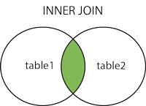
Join Queries
http://www.w3schools.com

Slide 10
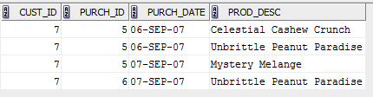
Join Queries
Inner join example
For an INNER JOIN…
Order of tables in FROM clause doesn’t matter
Order of tables in join condition doesn’t matter
SELECT cust_id, purch_id, purch_date, prod_desc
FROM candy_purchase JOIN candy_product
ON candy_purchase.prod_id = candy_product.prod_id
WHERE cust_id = 7

Slide 11
Join Queries
Alternate inner join syntax
Tables to be joined are listed in the FROM, separated by commas
The join condition is listed in the WHERE
What happens if you forget the join in the WHERE clause?
SELECT cust_id, purch_id, purch_date, prod_desc
FROM candy_purchase, candy_product
WHERE candy_purchase.prod_id = candy_product.prod_id
AND cust_id = 7

Slide 12
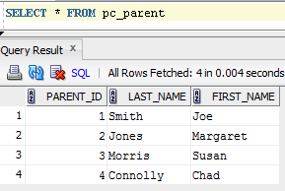
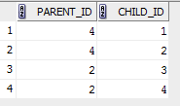
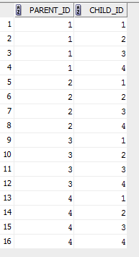
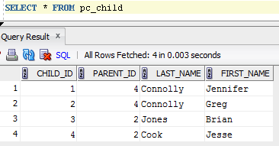
Join Queries
Alternate inner join syntax (join conditions omitted)
SELECT parent_id, child_id FROM pc_parent, pc_child
Expected Result
Actual Result

Slide 13
Join Queries
Alternate inner join syntax (join conditions omitted)
With the WEHRE clause omitted, you get a “product” of the tables
Every record in the first table is combined with every record in the second table
# of returned rows = # of rows in 1st table * # of rows in 2nd table
If 3 or more tables have omitted join conditions
# of returned rows is the product of the # of rows in each table
Potentially returns millions of records, slowing down network and server

Slide 14
Join Queries
Omitting join conditions in original inner join syntax
Oracle requires the ON clause, so this would generate an error
MySQL does not require the ON clause, so this would return a product of the number of rows in each table
SELECT cust_id, purch_id, purch_date, prod_desc
FROM candy_purchase JOIN candy_product
ON candy_purchase.prod_id = candy_product.prod_id
WHERE cust_id = 7;
SELECT cust_id, purch_id, purch_date, prod_desc
FROM candy_purchase JOIN candy_product
WHERE cust_id = 7;

Slide 15
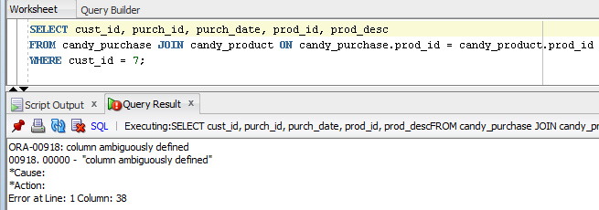
Join Queries
Qualifying field names
What if a join query retrieves a field that exists in both tables?

Slide 16
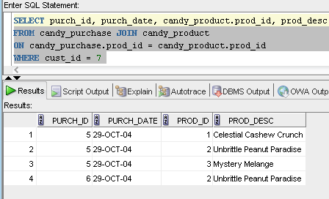
Join Queries
Qualifying field names
If multiple columns with the same name in different tables are referenced, they must be “qualified”
Preface the field name with the name of either table

Slide 17
Join Queries
Qualifying field names
Are the following two queries the same?
SELECT purch_id, candy_customer.cust_id, cust_name
FROM candy_purchase JOIN candy_customer
ON candy_customer.cust_id = candy_purchase.cust_id
WHERE candy_customer.cust_id = 5
SELECT purch_id, candy_purchase.cust_id, cust_name
FROM candy_purchase JOIN candy_customer
ON candy_customer.cust_id = candy_purchase.cust_id
WHERE candy_customer.cust_id = 5

Slide 18
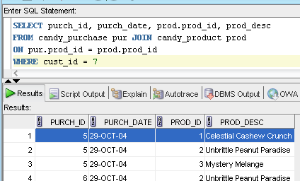
Join Queries
Table aliases
Names associated with tables for use in a single query
Aliases must be used everywhere in the query

Slide 19
Join Queries
Inner joins with more than 2 tables
Placing each INNER JOIN and ON clause on a separate line can make the query easier to read and understand
Multiple inner joins may be specified in any order
SELECT Column1, Column2, …
FROM Table1 INNER JOIN Table2
ON Table1.JoinColumn = Table2.JoinColumn
INNER JOIN Table3
ON Table2.JoinColumn = Table3.JoinColumn
WHERE SearchCondition(s)

Slide 20
Join Queries
Inner join example
Sometimes you need to include a table in join queries to provide needed links even if you don't include fields from the table in the SELECT clause
SELECT prod_desc
FROM candy_product JOIN candy_purchase
ON candy_product.prod_id =
candy_purchase.prod_id
JOIN candy_customer
ON candy_purchase.cust_id =
candy_customer.cust_id
WHERE cust_name = 'Bobby Bon Bons'

Slide 21
Sample Database (CANDY)
CANDY_CUSTOMER
CANDY_PURCHASE
CANDY_CUST_TYPE
CANDY_PRODUCT

Slide 22
Overview
Queries using multiple tables
Join queries
Inner
Outer
Self
Nested queries
Queries using set operations
Views

Slide 23
Join Queries
Outer joins
What if you want to create a query that retrieves records from one table, even if the records do not have matching records in one of the joined tables?
Inner joins do not accomplish this
Example
Create a query that retrieves the following:
Customer ID and name of every customer
The purchase dates of all of their purchases (if any)
Without duplicate records
Ordered by customer ID

Slide 24
Sample Database (CANDY)
CANDY_CUSTOMER
CANDY_PURCHASE
CANDY_CUST_TYPE
CANDY_PRODUCT

Slide 25
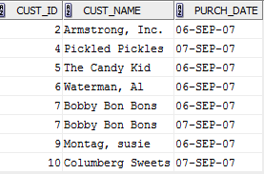
Join Queries
Outer joins
First attempt at example query
What happened to customers 1, 3, and 8?
SELECT DISTINCT c.cust_id, cust_name, purch_date
FROM candy_customer c JOIN candy_purchase p
ON c.cust_id = p.cust_id
ORDER BY c.cust_id

Slide 26
Join Queries
Outer joins
Retrieve all of the records from one table, plus the matching records from a second table, according to the join condition
Retrieves the records in the first table even if they don’t have matching records in the second table
Types of outer joins
Left
Right
Full

Slide 27
Join Queries
Left outer joins
Retrieves all of the records in the left (first) table, along with the joined records in the right (second) table if they exist (otherwise NULL values are present for result columns from the right table)
The “OUTER” term is optional and often omitted
The order of the tables in the FROM clause matters
SELECT Column1, Column2, …
FROM Table1 LEFT OUTER JOIN Table2
ON JoinCondition
WHERE SearchCondition(s);

Slide 28
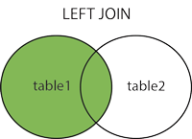
Join Queries
http://www.w3schools.com

Slide 29
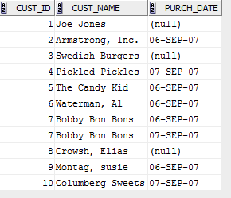
Join Queries
Left outer join example
SELECT DISTINCT c.cust_id, cust_name, purch_date
FROM candy_customer c
LEFT JOIN candy_purchase p ON c.cust_id = p.cust_id
ORDER BY c.cust_id

Slide 30
Join Queries
Right outer joins
Retrieves all of the records in the right (second) table, along with the joined records in the left (first) table if they exist (otherwise NULL values are present for result columns from the right table)
Again, the “OUTER” term is optional and often omitted
Again, the order of the tables in the FROM clause matters
SELECT Column1, Column2, …
FROM Table1 RIGHT OUTER JOIN Table2 ON JoinCondition
WHERE SearchCondition(s);

Slide 31
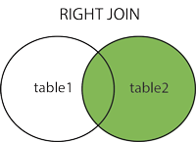
Join Queries
http://www.w3schools.com

Slide 32
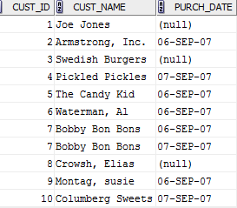
Join Queries
Right outer join examples
SELECT DISTINCT c.cust_id, cust_name, purch_date
FROM candy_customer c
RIGHT JOIN candy_purchase p ON c.cust_id = p.cust_id
ORDER BY c.cust_id
SELECT DISTINCT c.cust_id, cust_name, purch_date
FROM candy_purchase p
RIGHT JOIN candy_customer c ON c.cust_id = p.cust_id
ORDER BY c.cust_id

Slide 33
Sample Database (CANDY)
CANDY_CUSTOMER
CANDY_PURCHASE
CANDY_CUST_TYPE
CANDY_PRODUCT

Slide 34
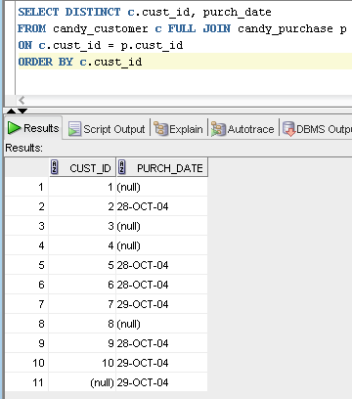
Join Queries
Full outer joins
Retrieves all of the joined records in both tables if they exist (otherwise NULL values are present for result columns from the table in which a joined record does not exist)
Assuming a purchase record was present without an associated cust_id

Slide 35
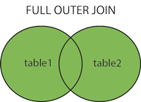
Join Queries
http://www.w3schools.com

Slide 36
Join Queries
General approach to outer joins with 3 or more tables
Multiple joins are processed from top to bottom
Table that you want to display ALL records from must always use an outer join
If the query contains subsequent joins, you must continue to join the result to other tables using an outer join
Create a query that retrieves:
Every customer ID and name
The description of every product the customer has ever purchased
Without duplicate records
Ordered by customer ID

Slide 37
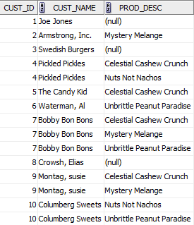
Join Queries
Outer joins with 3 or more tables
SELECT DISTINCT c.cust_id,
cust_name, prod_desc
FROM candy_customer c
LEFT JOIN candy_purchase p
ON c.cust_id = p.cust_id
LEFT JOIN candy_product pr
ON p.prod_id = pr.prod_id
ORDER BY c.cust_id

Slide 38
Overview
Queries using multiple tables
Join queries
Inner
Outer
Self
Nested queries
Queries using set operations
Views

Slide 39
Join Queries
Self joins
Sometimes database tables contain FKs that reference a field within the same table
A self join uses this to join a table with itself
Employee ID | Employee Name | Employee Manager ID
1 | Smith
2 | Jones
3 | Black | 1
4 | Gonzales | 1
5 | Kelley | 2
ProjectID | ProjectName | Parent ProjectID
1 | Hardware Support Intranet
2 | Exploration Database
3 | Hardware Support Database | 1
4 | Hardware Support Services | 1
5 | Hardware Support Interface | 1
6 | Exploration JSPs | 2

Slide 40
Join Queries
Self joins
Create a table alias so you can join the table to a copy of itself
Table “a”
Table “b”
Employee ID | Employee Name | Employee Manager ID
1 | Smith
2 | Jones
3 | Black | 1
4 | Gonzales | 1
5 | Kelley | 2
Employee ID | Employee Name | Employee Manager ID
1 | Smith
2 | Jones
3 | Black | 1
4 | Gonzales | 1
5 | Kelley | 2

Slide 41
Join Queries
Self joins
Example
SELECT a.emp_name, b.emp_name AS MANAGER
FROM employee a JOIN employee b
ON a.emp_manager_id = b.emp_id

Slide 42
Overview
Queries using multiple tables
Join queries
Inner
Outer
Self
Nested queries
Queries using set operations
Views

Slide 43
Nested Queries
Consist of a main query and a subquery
The subquery retrieves a search condition value for the main query
Find the purchase id, date, and pounds for all purchases of Celestial Cashew Crunch
SELECT purch_id, purch_date, pounds
FROM candy_purchase
WHERE prod_id =
(SELECT prod_id
FROM candy_product
WHERE prod_desc = 'Celestial Cashew Crunch')

Slide 44
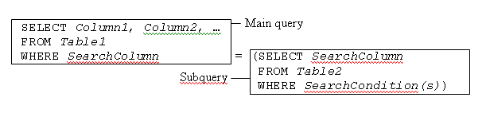
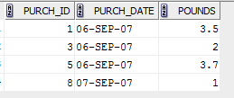
Nested Queries
SELECT purch_id, purch_date, pounds
FROM candy_purchase
WHERE prod_id =
(SELECT prod_id
FROM candy_product
WHERE prod_desc = 'Celestial Cashew Crunch')

Slide 45
Nested Queries
SELECT purch_id, purch_date, pounds
FROM candy_purchase
WHERE prod_id =
(SELECT prod_id
FROM candy_product
WHERE prod_desc = 'Celestial Cashew Crunch')
The subquery returns exactly one value
The SearchColumn data type in the main query must match the SearchColumn in the subquery
The SearchColumn is usually a foreign key value

Slide 46
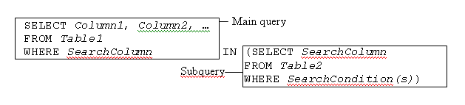

Nested Queries
Alternate format
SELECT cust_id, purch_id, purch_date, pounds
FROM candy_purchase
WHERE cust_id IN
(SELECT cust_id
FROM candy_customer
WHERE cust_type = 'P’)

Slide 47
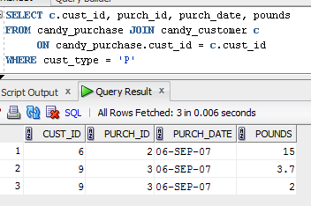
Nested Queries
Alternate format
Nested queries were actually unnecessary in the previous examples

Slide 48

Nested Queries
Nested queries with multiple subqueries
A nested query’s main query can have multiple search conditions whose values are specified by subqueries
SELECT purch_id, purch_date, pounds
FROM candy_purchase
WHERE prod_id =
(SELECT prod_id
FROM candy_product
WHERE prod_desc = 'Celestial Cashew Crunch’)
AND cust_id IN
(SELECT cust_id
FROM candy_customer
WHERE cust_type = 'P');
Can this query be written without any nested queries?

Slide 49

Nested Queries
Previous query without any nested queries
SELECT purch_id, purch_date, pounds
FROM candy_purchase pu
JOIN candy_product pr ON pu.prod_id = pr.prod_id
JOIN candy_customer c ON pu.cust_id = c.cust_id
WHERE c.cust_type = 'P'
AND pr.prod_desc = 'Celestial Cashew Crunch’;

Slide 50
Nested Queries
For many nested queries, you could achieve the same result with a join query
A nested query may seem more straight-forward than the equivalent join query
Restrictions
Final results can only come from the main query table
Execution time used to be slower but this is no longer the case with improved query optimizers
However, some nested query results can’t be retrieved through a join…

Slide 51
Nested Queries
Create a query that retrieves the IDs and names of all customers who have made an order in which the total pounds of the order is greater than the average pounds of all individual orders
Answer is developed in the next three slides

Slide 52
Sample Database (CANDY)
CANDY_CUSTOMER
CANDY_PURCHASE
CANDY_CUST_TYPE
CANDY_PRODUCT

Slide 53
Nested Queries
Strategy for creating and debugging nested queries
Create and debug the subquery(ies) first
Next work on the main query
Integrate the main and subquery(ies)
If the integration doesn’t run, debug it by hard-coding the search condition rather than using the subquery

Slide 54
Nested Queries
Strategy for creating and debugging nested queries
Create and debug the subquery(ies) first
Next work on the main query
SELECT AVG(pounds)
FROM candy_purchase;
Find average pounds per candy purchase
SELECT c.cust_id, cust_name, SUM(pounds)
FROM candy_customer c
INNER JOIN candy_purchase p
ON c.cust_id = p.cust_id
GROUP BY c.cust_id, cust_name
ORDER BY c.cust_id;
Find customer id, name, and total pounds per customer purchase

Slide 55
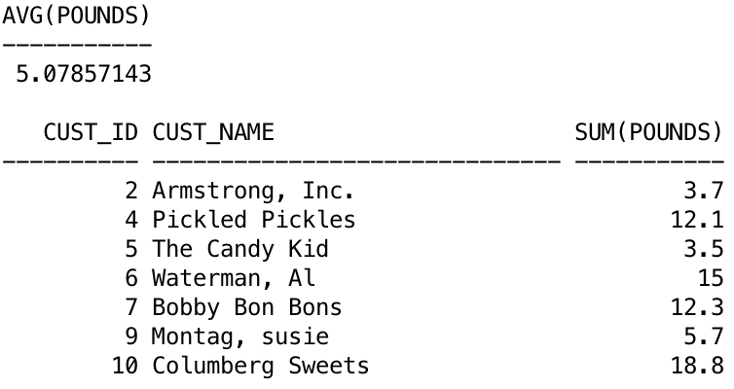
Nested Queries
Strategy for creating and debugging nested queries
Results of subquery and main query

Slide 56
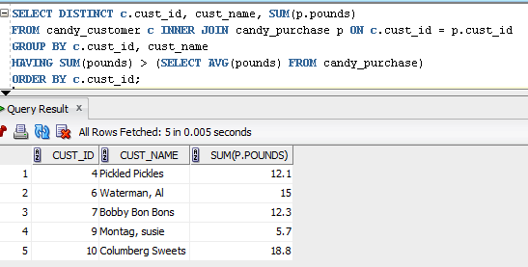
Nested Queries
Strategy for creating and debugging nested queries
Integrate the main and subquery(ies)

Slide 57
Nested Queries
Order of fields in the GROUP BY clause
Changing the order of the fields can change the order the rows are returned in, but the number of rows and their content will be the same
cust_name, c.cust_id is equivalent to c.cust_id, cust_name
SELECT c.cust_id, cust_name, SUM(pounds)
FROM candy_customer c
INNER JOIN candy_purchase p
ON c.cust_id = p.cust_id
GROUP BY c.cust_id, cust_name

Slide 58
Order of Evaluation
SQL clauses are evaluated in the following order
FROM
WHERE
GROUP BY
HAVING
SELECT
ORDER BY

Slide 59
Overview
Queries using multiple tables
Join queries
Inner
Outer
Self
Nested queries
Queries using set operations
Views

Slide 60
Queries Using Set Operations
Basic set operators
UNION
UNION ALL
INTERSECT
MINUS

Slide 61
Queries Using Set Operations
UNION and UNION ALL
Combines the retrieved recordsets of 2 independent queries
Example
Retrieve a list of all dates on which there was any activity (purchase or delivery)
SELECT purch_date
FROM candy_purchase
UNION
SELECT delivery_date
FROM candy_purchase;

Slide 62
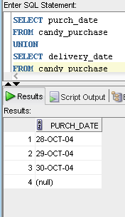
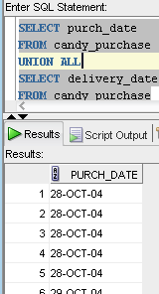
Queries Using Set Operations
UNION and UNION ALL
UNION: suppresses duplicate values
UNION ALL: returns ALL values

Slide 63
Queries Using Set Operations
UNION and UNION ALL Restrictions
Each SELECT query must retrieve…
Exactly the same number of fields
Fields must have the same corresponding data types
What if you want to retrieve two different sets of data with different data types using a single query?
Use placeholders in each unioned query
Placeholders can be null, text, number, etc.
But the data types must match in both queries
Use null to match anything

Slide 64
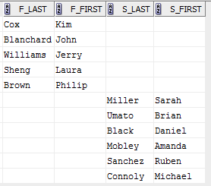
Queries Using Set Operations
UNIONing two different datasets
SELECT f_last, f_first, ' ' AS s_last,
' ' AS s_first
FROM nw_faculty
UNION ALL
SELECT ' ', ' ', s_last, s_first
FROM nw_student;

Slide 65
Queries Using Set Operations
INTERSECT and MINUS
INTERSECT: retrieves the matching records in two independent queries
MINUS: retrieves all of the records in the first query, “minus” the matching records in the second query
Not SQL-standard, and not available for many DBMSs
Not available in MySQL

Slide 66


Queries Using Set Operations
INTERSECT example
Which candy customers have actually purchased anything?
SELECT cust_id
FROM candy_customer
ORDER BY cust_id;
SELECT cust_id
FROM candy_customer
INTERSECT
SELECT cust_id
FROM candy_purchase
ORDER BY cust_id;

Slide 67
Queries Using Set Operations
INTERSECT alternatives
Use an INNER JOIN along with DISTINCT
Works with both Oracle and MySQL
SELECT cust_id
FROM candy_customer
ORDER BY cust_id;
SELECT DISTINCT c.cust_id
FROM candy_customer c
JOIN candy_purchase p
ON c.cust_id = p.cust_id
ORDER BY c.cust_id

Slide 68
Queries Using Set Operations
INTERSECT alternatives
Temporary views (works with both Oracle and MySQL)
A view is treated identically to a table
A “temporary view” is created in the FROM clause when it contains a SELECT clause
SELECT DISTINCT q1.cust_id
FROM (
SELECT * FROM candy_customer
) q1
INNER JOIN
(
SELECT * FROM candy_purchase
) q2
ON q1.cust_id = q2.cust_id
ORDER BY q1.cust_id
Alias necessary for join condition

Slide 69
Queries Using Set Operations
INTERSECT alternatives
Example where an inner join without temporary views won’t work nicely
List the customers who have purchased both “Celestial Cashew Crunch” and “Mystery Melange”
Let’s write this using both an INTERSECT and temporary views…

Slide 70

Queries Using Set Operations
INTERSECT solution
SELECT cust_name
FROM candy_customer c
JOIN candy_purchase p
ON c.cust_id = p.cust_id
JOIN candy_product pr
ON pr.prod_id = p.prod_id
WHERE pr.prod_desc = 'Celestial Cashew Crunch’
INTERSECT
SELECT cust_name
FROM candy_customer c
JOIN candy_purchase p
ON c.cust_id = p.cust_id
JOIN candy_product pr
ON pr.prod_id = p.prod_id
WHERE pr.prod_desc = 'Mystery Melange';

Slide 71
Queries Using Set Operations
INTERSECT alternative using temporary views
SELECT DISTINCT q1.cust_name
FROM (
SELECT c.cust_id, cust_name
FROM candy_customer c
JOIN candy_purchase p ON c.cust_id = p.cust_id
JOIN candy_product pr ON pr.prod_id = p.prod_id
WHERE pr.prod_desc = 'Celestial Cashew Crunch'
) q1
INNER JOIN
(
SELECT c.cust_id, cust_name
FROM candy_customer c
JOIN candy_purchase p ON c.cust_id = p.cust_id
JOIN candy_product pr ON pr.prod_id = p.prod_id
WHERE pr.prod_desc = 'Mystery Melange'
) q2
ON q1.cust_id = q2.cust_id;

Slide 72


Queries Using Set Operations
MINUS example
Which candy customers have never purchased anything?
SELECT cust_id
FROM candy_customer
ORDER BY cust_id;
SELECT DISTINCT cust_id
FROM candy_purchase
ORDER BY cust_id;
SELECT cust_id
FROM candy_customer
MINUS
SELECT cust_id
FROM candy_purchase
ORDER BY cust_id;

Slide 73
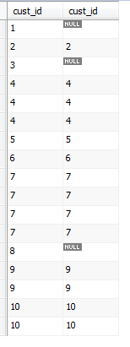

Queries Using Set Operations
MINUS alternative
Use a LEFT JOIN along with IS NULL
Works in both Oracle and MySQL
SELECT c.cust_id, p.cust_id
FROM candy_customer c
LEFT JOIN candy_purchase p
ON c.cust_id = p.cust_id
ORDER BY c.cust_id;
SELECT c.cust_id
FROM candy_customer c
LEFT JOIN candy_purchase p
ON c.cust_id = p.cust_id
WHERE p.cust_id IS NULL
ORDER BY c.cust_id;

Slide 74
Overview
Queries using multiple tables
Join queries
Inner
Outer
Self
Nested queries
Queries using set operations
Views

Slide 75
Views
A view is a virtual table based on a query
It can be used to restrict the fields that certain users can access
It can be used to simplify join queries
You can think of it as a “stored query”

Slide 76
Views
Simple view
Based on a single table
Primary use: hides fields to control access
Users can select, insert, update, and delete from simple views just as with tables
CREATE VIEW candy_customer_view AS
SELECT cust_id, cust_name, cust_type,
cust_addr,cust_zip
FROM candy_customer;
SELECT *
FROM candy_customer_view;

Slide 77
Views
Complex view
Created by joining multiple tables
Primary use: to simplify queries
Users can select from complex views
Users cannot insert, update, and delete from complex views
These “action queries” only work on single tables
CREATE VIEW purchase_product_view AS
SELECT purch_date, delivery_date,
prod_desc, pounds
FROM candy_purchase pu
INNER JOIN candy_product pr ON pu.prod_id = pr.prod_id;

